Slide 1
Shortest Path and Pathfinding
Eric Ianni

Slide 2
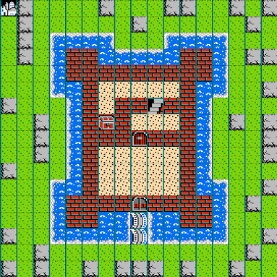
Let’s Raid a Castle!
Goal: The King’s treasure
Start: Small Village
Abilities:
Walk
Swim
Climb
Notes:
Ask class how they would pathfind for each ability

Slide 3
What is Pathfinding?
Identifying a route from Point A to Point B
Examples:
Driving to the store
Internet packet forwarding
Crossing a room
Notes:
Ask audience for ideas?

Slide 4
Pathfinding and Graphs
Computers don’t think like humans
Graphs help make complex systems useable by computers
Converting the real world into a graph
Objects = vertices
Relationships = edges
Notes:
Humans rely on seeing the big picture and intuition
Computers need more structure

Slide 5
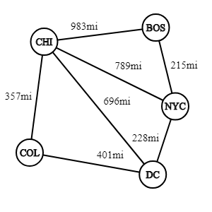
Example: Bus-Network
Vertices = Cities
Edges = Routes
Weights = Distances

Slide 6
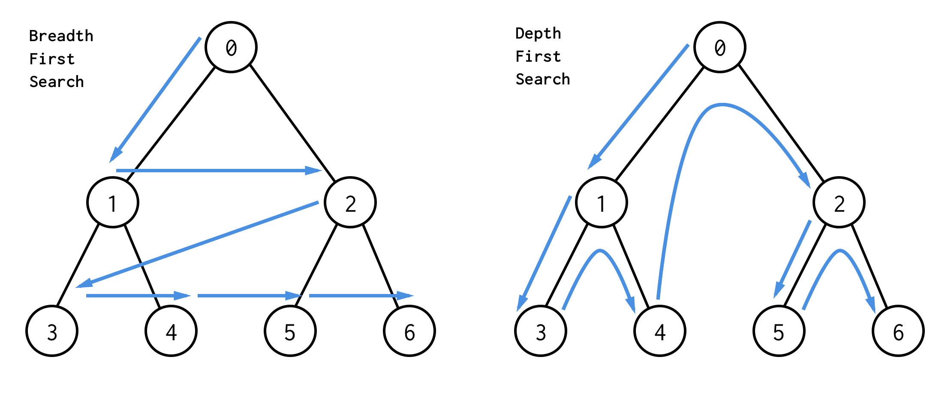
Brute Force Graph Search

Slide 7
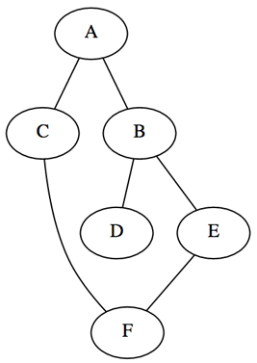
DFS and BFS in Action
Pre-Experiment Questions
Why don't DFS and BFS come up with the same path?
Why does BFS seem to be able to find shorter paths than DFS?
Pay attention to the number of steps required, why are they different?
Notes:
Pose the questions, experiment, and then return and give answers

Slide 8
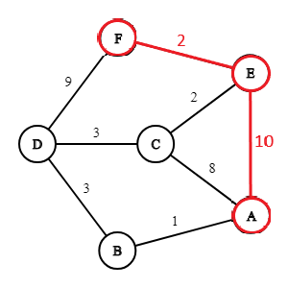
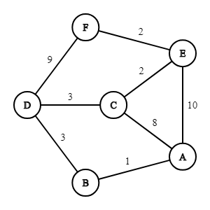
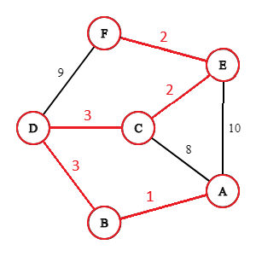
Shortest Path Problems
Graphs can have many paths from A to B
What makes one path shorter?
Sum of the edge weights

Slide 9
Shortest Path: DFS and BFS
Why are they not suited?
DFS isn’t guaranteed to find the shortest path
BFS only works if the edge weights are the same
We need other solutions

Slide 10
Dijkstra’s Algorithm - Plain English
Add the source node to a priority queue with a priority of 0
Select the node from the queue with the highest priority
Calculate the cost to visit each neighbor. To calculate this, add the cost to reach the current node from the source vertex to the cost of traveling to the neighbor
If this total cost is less than the known cost to reach each neighbor node, update the cost and add the neighbor to the queue with a priority of the new cost
Repeat steps 2-4 until you find the target node

Slide 11
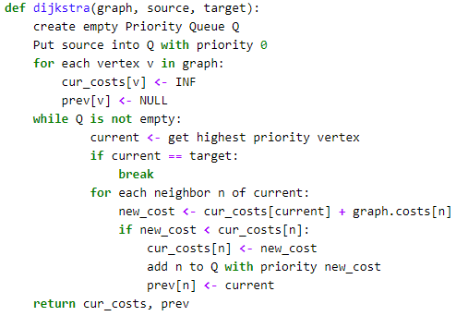
Dijkstra’s Algorithm - Formal

Slide 12
Dijkstra’s Algorithm - Implementation
Things we will need
A way to represent maps
Graph Class
Priority Queue Class
Dijkstra’s Algorithm

Slide 13
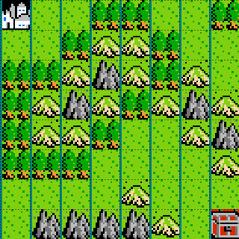
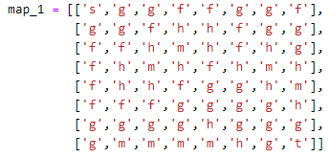
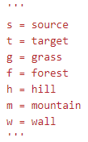
Dijkstra’s Algorithm - Maps

Slide 14
Dijkstra’s Algorithm - Graph Class
What does the class need to do?
Parse map into the cost of moving into each type of terrain
Know map specifics: height, width, source, and target
Provide access to this information

Slide 15
Dijkstra’s Algorithm - Priority Queue Class
What features does our class need?
Store all the elements
Add elements to queue
Sort elements so the item with the highest priority is at the front
Remove the first item and return it

Slide 16
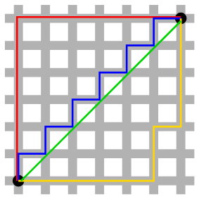

A* - Algorithm
Just like Dijkstra’s Algorithm, but with Heuristics
What is a Heuristic?
An Educated guess

